Slide 1
St. Michael’s CE High School A Church of England Academy
Welcome
Wellbeing Evening 2023

Slide 2
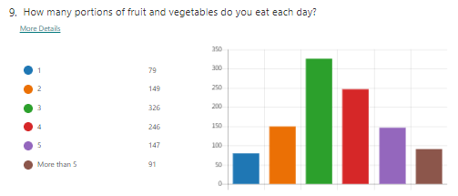
Pupil survey 2022
23% of pupils are eating at least 5 portions of fruit and vegetables a day
30% do not bring a drink of water to school
20% of pupils do not eat breakfast

Slide 3
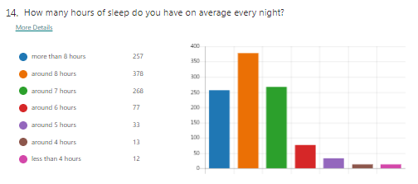
Pupil survey 2022
135 pupils get less than 7 hours sleep a night

Slide 4
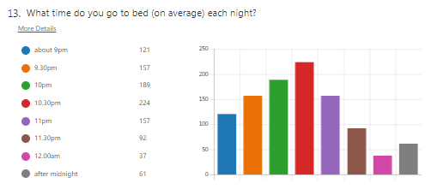
Pupil survey 2022
61 (6%) pupils go to bed AFTER midnight
349 (37%) say they go to bed at 11pm or later

Slide 5
Pupil survey 2022
Pupils exercise out of school

Slide 6
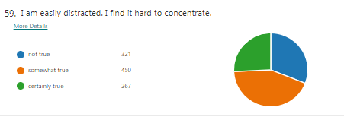
Pupil survey 2022
26% of pupils say they find it hard to concentrate in lessons.

Slide 7
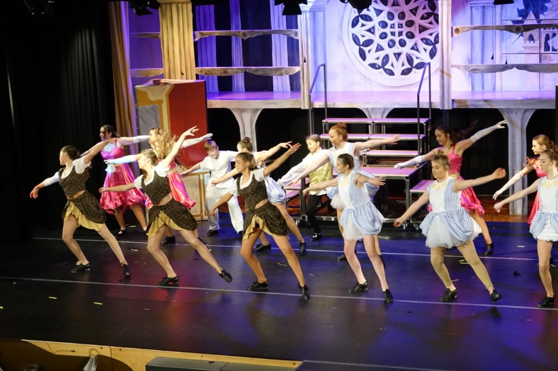
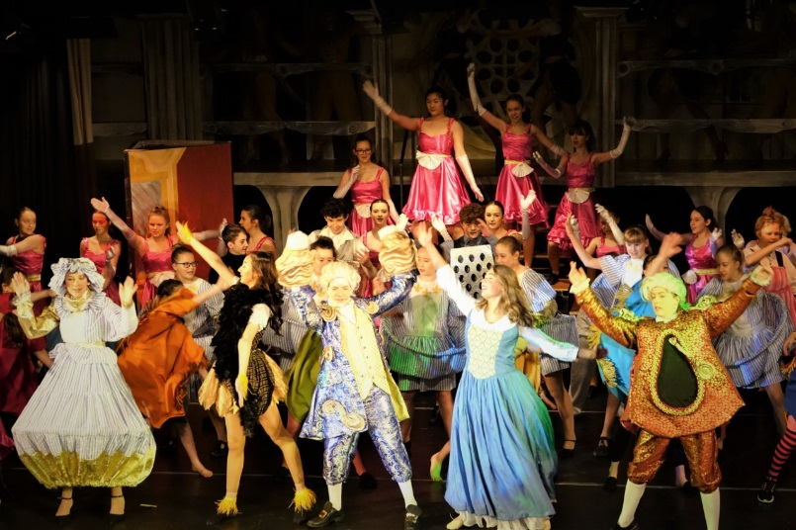
How can pupils become more involved?
drama
orchestras
dance
More than 150 pupils involved in the school production!
choirs

Slide 8
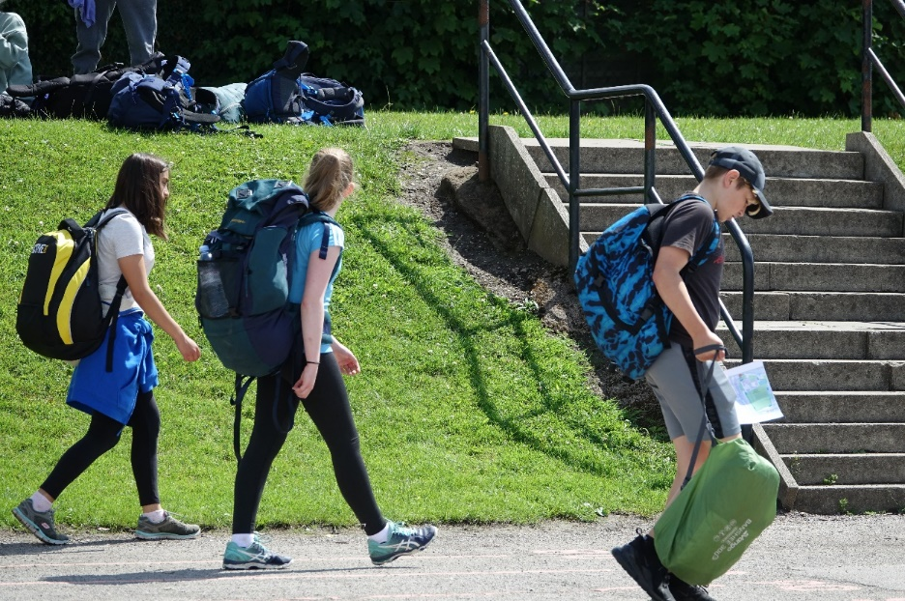
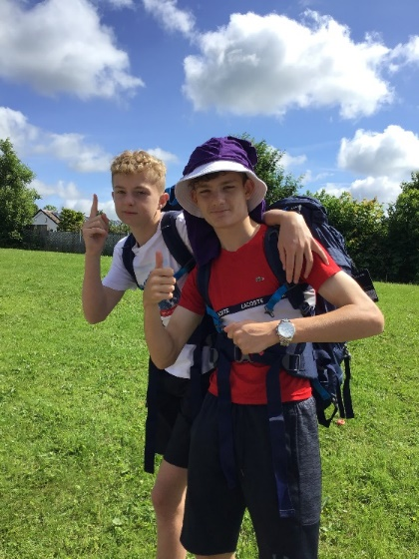
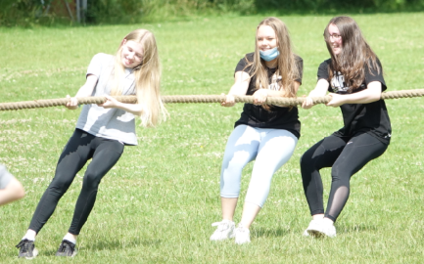
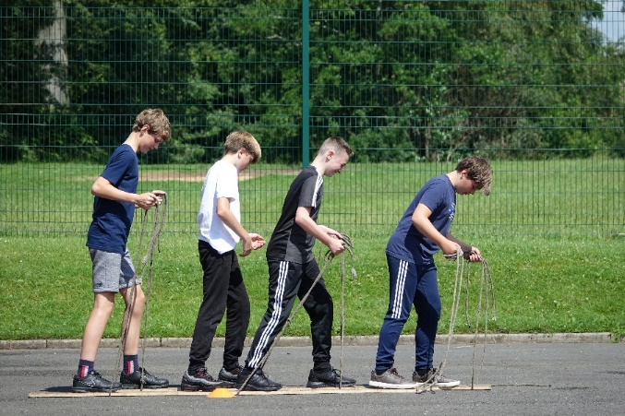
Expedition
physical
teambuilding
resilience
First aid
Nature / stewardship
408 pupils in Years 10 and 11 passed Bronze Duke of Edinburgh’s Award.
More than 200 in Year 9 signed up!

Slide 9
Agenda
Welcome and Introduction Mrs J Jenks (Headteacher)
Wellbeing, Help and Support Mrs J Monaghan (Pupil Engagement Coordinator Wellbeing)
Compass Bloom Mental Health Support Team Chloe Murphy and Ruth Mills (Education Mental Health Practitioners)
Online Safety Miss L O’Malley (Online Safety/Prevent Coordinator)
Wellbeing Mr D Gow (Year 8 Pupil Manager)
Q&A information and Close Mr J Chadwick (Deputy Headteacher-Wellbeing)

Slide 10
Wellbeing Evening
Joanne Monaghan
Pupil Engagement Coordinator: Wellbeing
Deputy DSL

Slide 11
How do we support our pupils’ wellbeing?
Tier 1
SCHOOL - Tutors / Pupil Managers / Pastoral Leads / Christian Youth Worker / Pupil Engagement Co-ordinator: Wellbeing / Pupil Engagement Co-ordinator: Behaviour / SENCO / Teachers
ONLINE - Kooth / Young Minds / Digital Healthy Schools / Shout / Alumina / BEAT
Tier 2
School Nurse / Compass Bloom / Butterfly & Phoenix / Mind Lancashire / Barnardos (Young Carers)
Tier 3
CBT Therapist / Specialist Teacher / CAMHS /
Early Help Assessment – Children and Family Wellbeing Service (CFW) – Family Support Worker, Child Action North West (CANW), KEY

Slide 12
Online Support and Advice
selfharm.co.uk

Slide 13
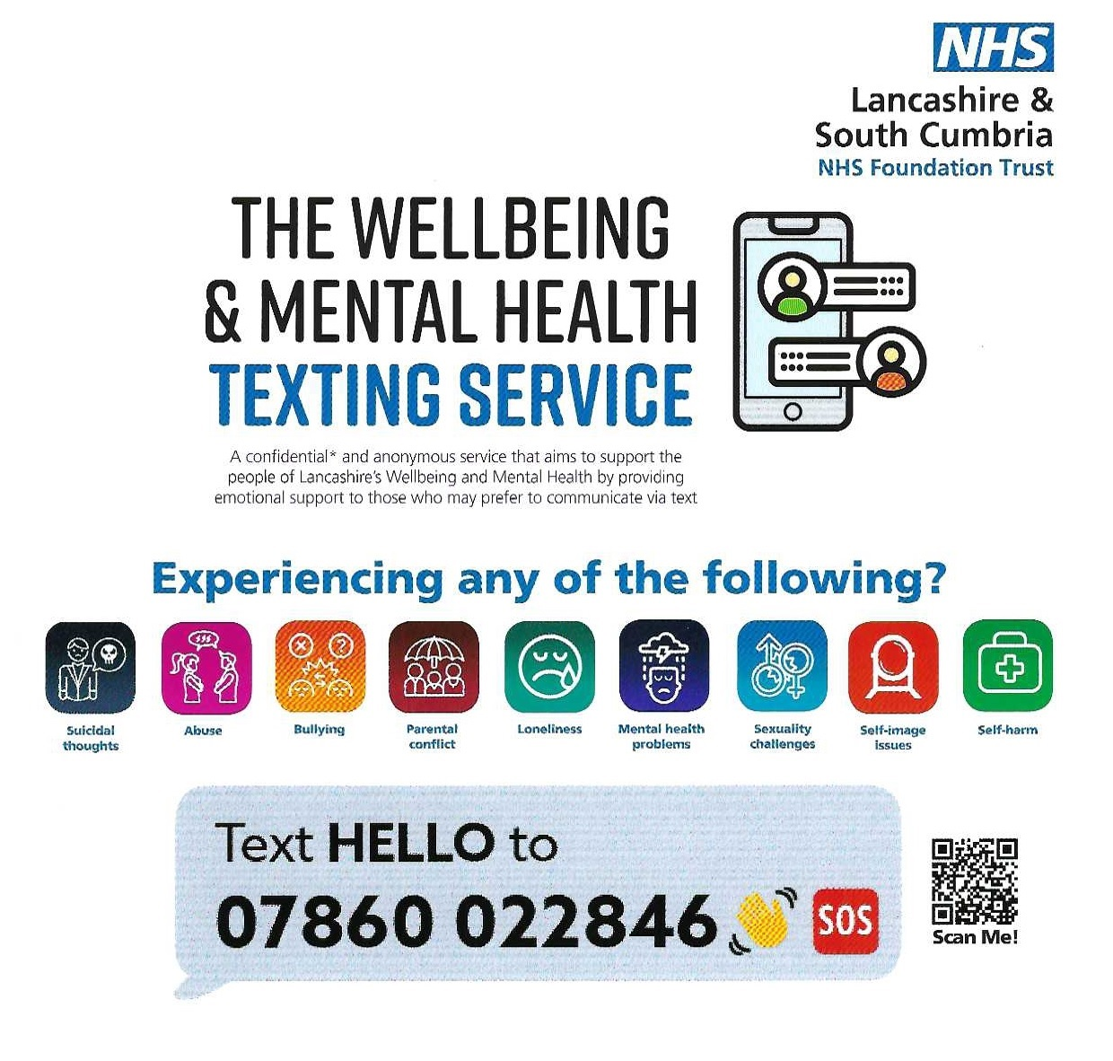
Local Support Services
lancashire.gov.uk/youthzone
School
Nursing
Chat Health text service
07507 330 510
lancsyoungpeoplefamilyservice.co.uk/
school-nursing
healthyyoungmindslsc.co.uk
01257 517240

Slide 14
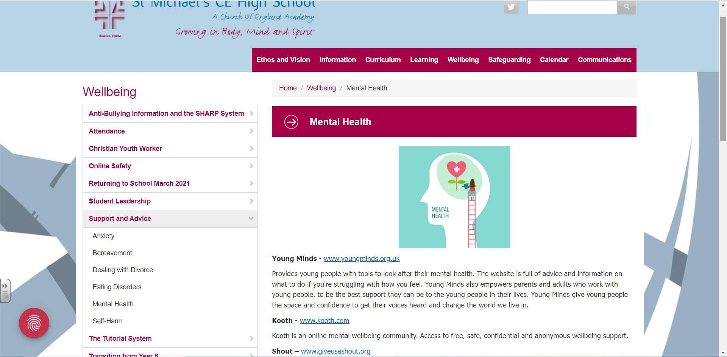
School Website – Wellbeing

Slide 15
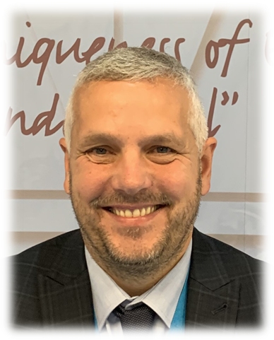
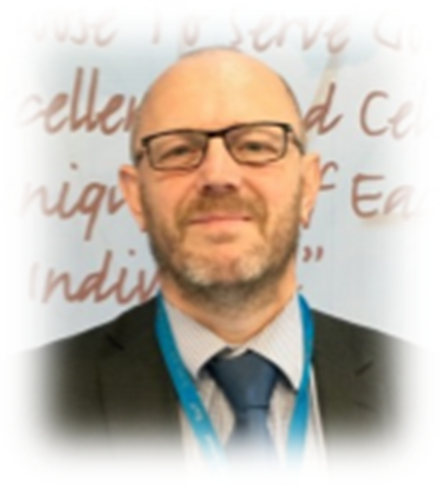
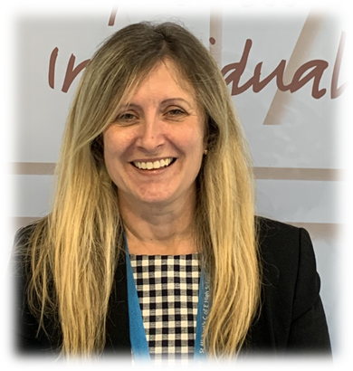
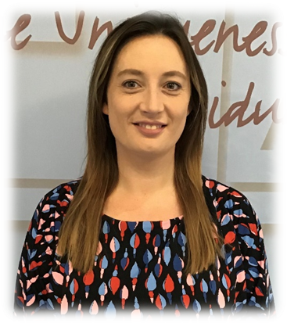
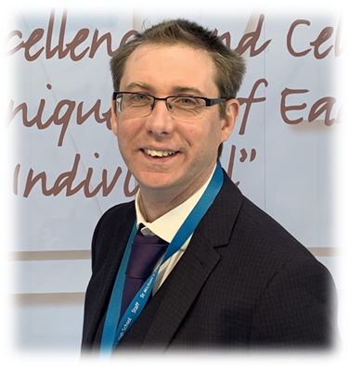
Pastoral Staff at St Michael’s

Slide 16
Agenda
Welcome and Introduction Mrs J Jenks (Headteacher)
Wellbeing, Help and Support Mrs J Monaghan (Pupil Engagement Coordinator Wellbeing)
Compass Bloom Mental Health Support Team Chloe Murphy and Ruth Mills (Education Mental Health Practitioners)
Online Safety Miss L O’Malley (Online Safety/Prevent Coordinator)
Wellbeing Mr D Gow (Year 8 Pupil Manager)
Q&A information and Close Mr J Chadwick (Deputy Headteacher-Wellbeing)

Slide 18
Mental health support team
Presented by Chloe and Ruth

Slide 19
TABLE OF CONTENTS
01
Who we are
02
What we do
03
A note on resilience
04
Emhp support
05
How to access
06
signposting

Slide 20
WHO WE ARE
WHAT IS A MENTAL HEALTH SUPPORT TEAM?
An early intervention service with a preventative approach to children & young people's mental health
We work across Chorley, South RIBBLE, Preston and West Lancs
Supporting CYP aged 5-18 across 56 settings: Primary, Secondary and Colleges.
List available on website at:
https://www.compass-uk.org/services/west-and-central-lancashire-mhsts/
Notes:
https://www.compass-uk.org/services/west-and-central-lancashire-mhsts/

Slide 21
What we do
Three core functions
We deliver brief evidence-based interventions (6-8 session) for mild-to-moderate mental health difficulties (1:1, parent-led or groups)
We support the senior mental health lead (where established) in each school or college to introduce or develop their whole school or college approach
We give timely advise to school and college staff and liaise with external specialist service to help children and young people to get the right support at the right time to enable them to stay in education.

Slide 22
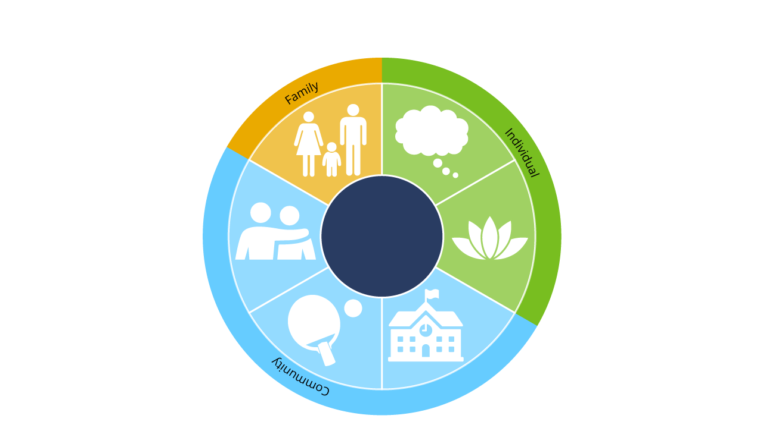
Supporting Resilience
& wellbeing post lockdown
Resilience and work with CYP/schools/family and community
Support steps to
help thinking positively
*Strong family relationships
*Supportive social networks
Self regulate and
manage stress
*Physical activities
*Enjoying school/college
(Masten 2014)
© MindEd/Royal College of Psychiatrists, Department for Education and Health Education England 2020.
Notes:
Part of the Wellbeing For Education Return funded training during covid. Links impact of lockdown (lots of these elements became limited or strained, some thrived in some areas). Model supports prevention and links to the whole school approach to mental health and wellbeing. Schools can support resilience e.g. a space for social networks, physical activity, things they enjoy (extra curricular), as well as teaching ways to manage stress (curriculum), and engaging with families (e.g., parent events). MHST aim is to support school with these kind of activities (universal and targeted). MHST also aim to actively engage with families and community directly e.g. linking to community support networks, partnership working, community events.

Slide 23
What is an EMHP?
EDUCATION MENTAL HEALTH PRACTITIONER
SUPPORT CHILDREN AND YOUNG PEOPLE IN PRIMARY AND SECONDARY SCHOOLS AND COLLEGES WITH COMMON MENTAL HEALTH DIFFICULTIES
PROVIDE 1;1 SUPPORT
WORK WITH SMALL GROUPS
SUPPORT SCHOOLS TO DEVELOP A WHOLE SCHOOL APPROACH AND ETHOS TO MENTAL HEALTH
Support and give advice to parents
WHAT DO OUR YOUNG PEOPLE SAY?
I have learned lots of ways to control my worries...I feel much happier now
They helped me to understand why I get funny feelings in my body when I am worried
It helped me to realise that I am not the only one who feels this way
I stopped doing things I enjoyed and stayed in my room all the time – now I am starting to enjoy life again

Slide 24
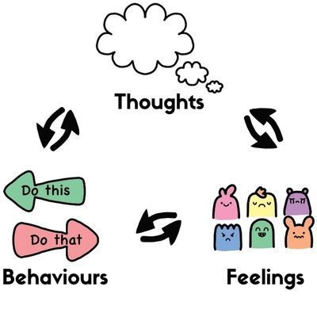
Low Intensity CBT Based Interventions
PSYCHOEDUCATION
WHAT ARE MY feelings?
WHY DO I FEEL THIS WAY?
WHAT MAINTAINS MY FEELINGS?
HOW CAN I CHANGE THE WAY I FEEL?
WEHEARTCBT.COM
WORRY MANAGEMENT
GRADED EXPOSURE – FACING YOUR FEARS
BEHAVIOURAL ACTIVATION FOR LOW MOOD

Slide 25
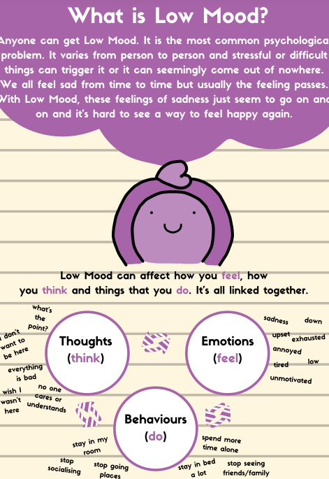
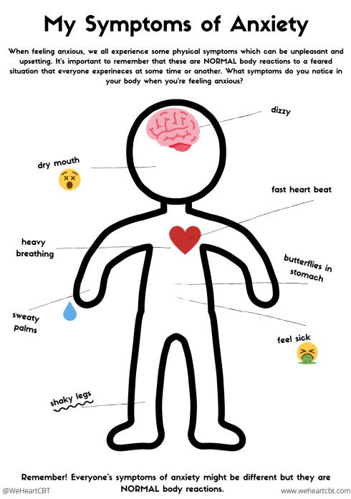

Slide 26
How to access us
Making a request for support
For further information and advice, you can visit our website on https://www.compass-uk.org/services/west-and-central-lancashire-mhsts/ or call us
School have access to regular Consultations with Compass Lancs locality Supervising Practitioner during link sessions
Request for support form to be completed by school
We can offer advice and sigposting

Slide 27
We can’t work with
but can support signposting
Child is currently engaging with another emotional-wellbeing service
Active high risk self-harm and/or experiencing significant suicidal thoughts/behaviours (indicating planning and expressing intent)
Have a diagnosis of or may need support for ‘clinical’ depression, severe anxiety, Obsessive Compulsive Disorder (OCD), schizophrenia, eating disorders, psychosis.
Are requiring long-term therapy (CYP may need more specialist support over a longer period of time)
Show signs of PTSD/trauma
Are in crisis or require out of hours support
Parents mental health
Notes:
brief

Slide 28
signposting
Lancashire positive minds – network of parents with lived experience supporting families
https://www.lancashirepositiveminds.co.uk/
Kooth - https://www.kooth.com/
Digital confidential support for young people
Young minds – parent support, info and helpline
https://www.youngminds.org.uk/parent/
Charleywaller website - parent resources e.g. emotions and gcses
https://charliewaller.org/resources/
Samaritans and dealing with difficult conversations
https://www.samaritans.org/how-we-can-help/

Slide 30
Agenda
Welcome and Introduction Mrs J Jenks (Headteacher)
Wellbeing, Help and Support Mrs J Monaghan (Pupil Engagement Coordinator Wellbeing)
Compass Bloom Mental Health Support Team Chloe Murphy and Ruth Mills (Education Mental Health Practitioners)
Online Safety Miss L O’Malley (Online Safety/Prevent Coordinator)
Wellbeing Mr D Gow (Year 8 Pupil Manager)
Q&A information and Close Mr J Chadwick (Deputy Headteacher-Wellbeing)

Slide 31
Online Safety
Miss L O’Malley January 2023

Slide 32
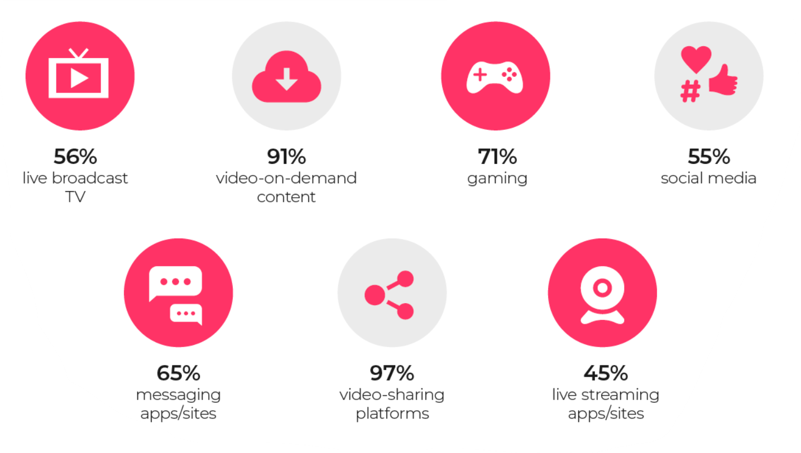
How are children aged 5 – 15 using the internet?
Source:
Ofcom 2020-21
Internetmatters.org
Notes:
Research by Ofcom in 2020 found that nearly all children aged 5 – 15 went online. Laptops and mobiles were the most used devices for going online, used by seven in ten children.
Children were twice as likely to watch TV programmes on video-on demand than live TV. Almost all children (91%) watched any type of on demand videos compared to watching live TV.
Many children are also gaming online, around 71% of young people. Some gamers will also stream their own content, or watch other streaming services such as twitch.
55% of children use social media, however this number is 87% for children ages 12-15. It is important to note here that most social media platforms are restricted to users ages 13+.

Slide 33
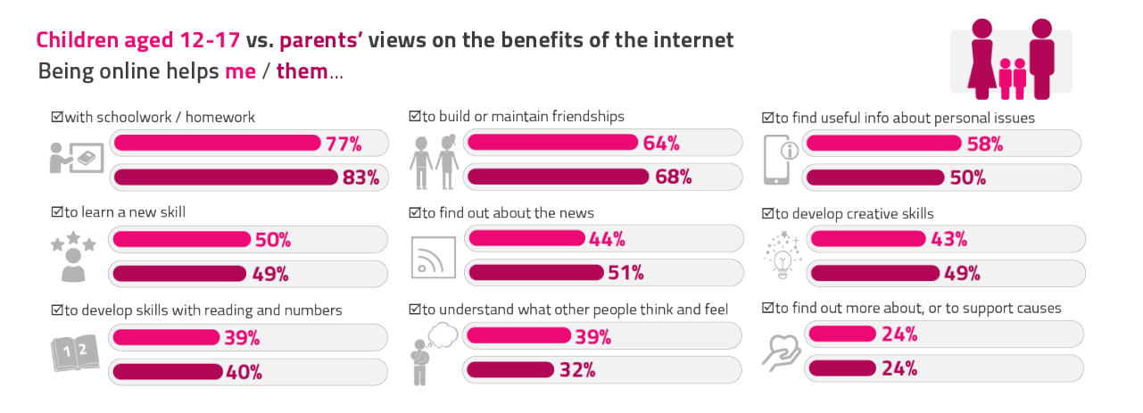
Recognising the benefits
Source:
Ofcom 2022
Children and Parents: Media Use and Attitudes report
Notes:
Data from the Media use and attitudes from Ofcom 2022 found that generally, both parents and children agree that there are many benefits to being online. We recognise that being online supports pupils with their school work, and also can be useful for young people to access new skills or find out about the news. It can also be a place where young people get support for personal issues.

Slide 34
Social media
87%
91%
of 12 – 15 year olds use social media
of 12 – 15 year olds use chat or messaging sites and apps
Source:
Ofcom 2020-21
Internetmatters.org
Notes:
87% of 12 – 15 year olds are using social media today. The range of sites and apps used is diverse.
The most commonly used apps include Instagram, TikTok, Snapchat, Facebook, WhatsApp and Twitter.
Social media can have a number of different risks. One of them is linked to the ‘fear of missing out’ or FOMO which it is sometimes referred to. Social media can present an image or lifestyle in which young people can feel pressured to fit in with. There is a fear on missing out on being part of the crowd, or a fear that they will not have a strong social status.
Social media also gives a minute by minute account of what friends, peers and celebrities are doing which can negatively impact on mental health if people feel that they are subjected to pressure to post or constant comparison. Many young people have mentioned that they would delete a selfie or photo that they have posted if they don’t get enough likes. They feel ashamed if their content doesn’t get as many likes as they feel it should.
Obsessive use can also be a risk related to social media. On average users spend around 55 minutes scrolling through short videos of around a minute in length. Most of the posts on TikTok by influencers are between 4 and 10pm meaning there is the most engagement and some teenagers have admitted they are addicted to Tiktok spending more than 7 hours a night, losing track of time because they are scrolling.

Slide 35
App minimum age
Notes:
The minimum age for apps such as Snapchat, Tiktok and Instagram is 13. WhatsApp which has a minimum age of 16.
Research from Ofcom found that around a third of children have a false social media age of 18+.
Part of the problem is that is young people add a false age to start their profile, for example here Adam is 8 and gives a false date of birth to sign up to an app to make him 13, in 5 years time when Adam is 13, his online age on his profile will be 18. This means he may be able to access adult content despite only being 13.
Some apps such as Tiktok automatically block the direct messaging function to under 16s. However,

Slide 36
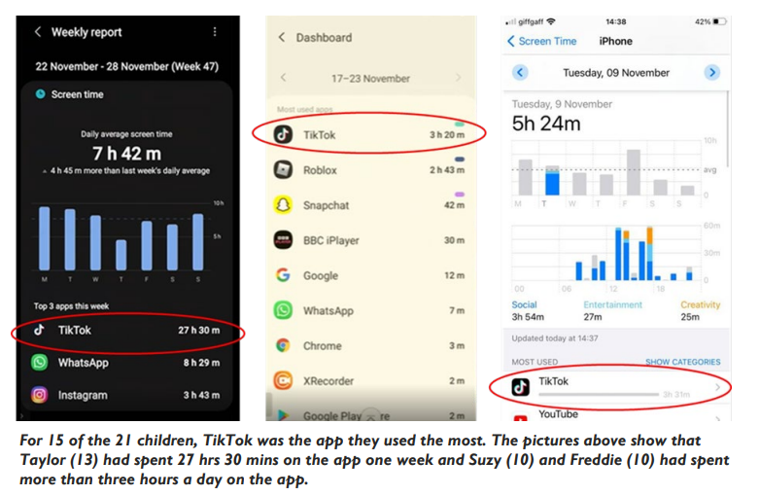
TikTok
Notes:
In the most recent Media Use and Attitudes report, Ofcom found that the most popular social media app was TikTok.
On average users spend around 55 minutes scrolling through short videos of around a minute in length. Most of the posts on TikTok by influencers are between 4 and 10pm meaning there is the most engagement and some teenagers have admitted they are addicted to Tiktok spending more than 7 hours a night, losing track of time because they are scrolling.
Data above shows examples of children’s phones from the research, with the first child on the left spending 27 hours and 30 mins on the app in just one week.
Although lots of the videos on the app can be innocent, for example make up application, dance crazes and dog videos, a recent BBC Panorama investigation found some shocking statistics. It is not necessary for users on TikTok to have a profile, however having a profile shapes the users feed. Tiktok’s main pull is its for you page which recommends posts based on your activity. For example, if you follow dances or artists, you will be recommended similar videos. However, this algorithm also means that increasingly violent or disturbing videos can be pushed on to young people if they have watched one video and then another which is similar.
The example shown in the Panorama documentary was a video in which a dog was abused, which then recommended a video with two people arguing, then another video with a fight before lastly showing domestic abuse. This is the same algorithm for users of all ages and Tiktok has explained it ‘deliberately pushes’ content which users might not be interested in to create diverse content. This can lead to young people being shown gang related or domestic violence even though they have not deliberately searched for it.
Similarly, we are also seeing an increase in the number of children essentially self diagnosing for conditions such as ADHD as it is seen as almost fashionable on the site. On TikTok there are numerous videos titled ‘How to know you have ADHD’ or ‘signs you have ADHD’. Similar videos can be found relating to anxiety which can lead children to self diagnose

Slide 37
Cyberbullying
Cyberbullying is when someone bullies others using electronic means.
Notes:
Another huge downside of online relationships is cyber bullying.
Bullying as we already know is the repetitive, intentional hurting of one person or group by another person or group.
Unfortunately, as more people use the internet, bullying now takes place more often on the internet.
The means have changed. Electronic means are used more often, and this includes social media and messaging services accessed on a mobile, on a tablet or gaming platform.
Each year in school we celebrate Safer Internet Day. Last year’s theme focused on how we can have more respectful relationships online, looking specifically on gaming as unfortunately more than half of children feel like people are meaner to each other online compared to in real life.
This year’s Safer Internet Day theme is ‘Want to talk about it?’, encouraging people to have more conversations about their lives online.

Slide 38
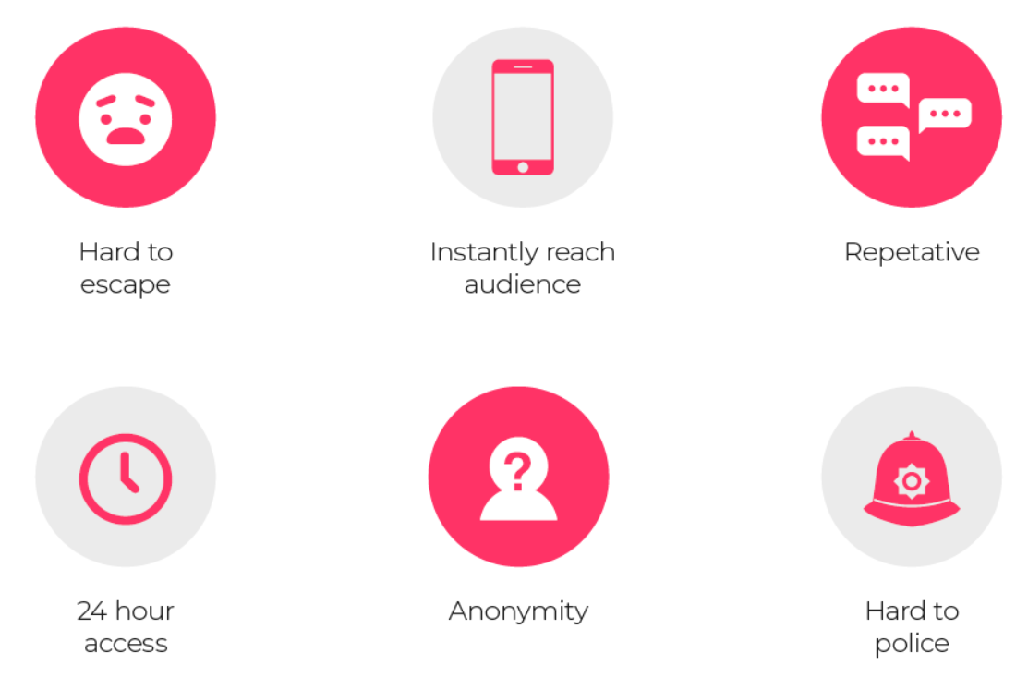
Cyberbullying
Notes:
In order for us to open up more conversations about cyberbullying, we need to understand a little more about what cyber bullying is and how it is different to real world bullying.
How is cyberbullying different to real world bullying?
Hard to escape – Leaving the bullies behind in the school playground is no longer an option. The bullies are with you wherever your connected device is.
24 hour access – Children often check their devices through out the evening and sometimes during the night
Instantly reach a large audience – Messages and images can be shared quickly via messaging or social media. The audience can quickly grow to people you don’t even know
Anonymity - Some platforms allow you to stay anonymous. People often say things online they would not say in real life.
Lots of repetition with likes and shares – Can quickly spread outside the child’s own network of friends. We have all seen videos or images that have gone “viral”
It’s hard to police – Social media networks, online games, and other online tools have report functions but only work if the children use them.

Slide 39
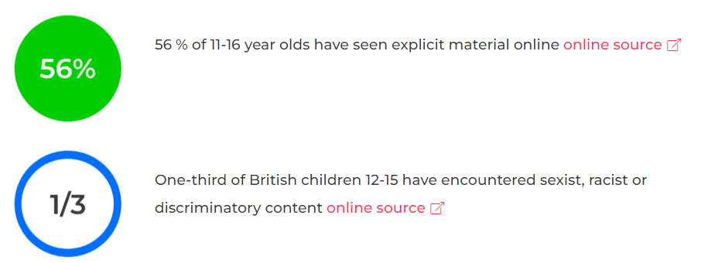
Harmful and inappropriate content
Notes:
https://www.internetmatters.org/issues/inappropriate-content/learn-about-it/
In all apps there are the dangers of children seeing harmful content.
Inappropriate content might range from an explicit pop up add on a free game, videos showcasing children’s characters in adult situations or forums promoting things such as self harm. It might also be the case that an innocent search can expose children to content that might make them feel upset and confused.
Around half of 11 -16 year olds have seen explicit material online whilst one third of 12 – 15 year olds report encountering sexist, racist or discriminatory content. A now high profile example of this type of content is Andrew Tate, an influencer who regularly shared extremist views relating to misogyny, feminism, the far-right, racism and homophobia. Although now banned on many social media sites, this is just one example of how children could be viewing harmful content which might upset or worry them, or influence their views.

Slide 40
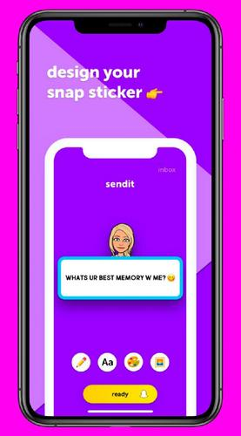
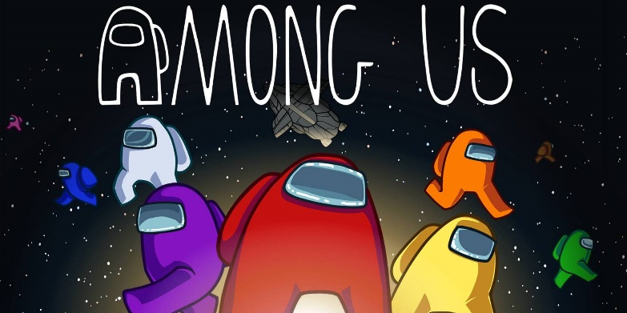
Apps to be aware of
Notes:
Other than TikTok, some more key apps to be aware due to various risks are listed on the screen.
Omegle – Omegle is a free online chat site that lets you speak to other users without registering. You can choose to talk via text chat or video call. The service randomly pairs users in one-on-one chat sessions where they chat anonymously using the names "You" and "Stranger" meaning you have no control over who you can talk to. Young people are sharing personal information and could enable grooming and online predators.
Wizz acts in a similar way to omegle as it allows you to speak to other users, however this platform requires a profile and matches people based on specific interests. Wizz is not suitable for children under 16 and although it does have a minimum age, it is possible to make an account.
Among us - Among Us is a teamwork game where users join a game, which auto-fills with people on the internet from around the world. Alternatively, you can co-ordinate to play with friends and fill your own 'local' game which requires a password to join. The game begins when all spaces are filled and the app randomly selects a number of "imposters" and allocates the rest of the players as "crewmates".Games can have one, two or three imposters and everyone is aware of how many there are from the beginning. This game has a lot of violence, has an unmonitored chat function and also in-app purchases.
Roblox –Roblox is a gaming platform where multiple players interact and play together online. The site has a collection of games aimed at 8-18 year olds, however players of all ages can use the site. All games are multiplayer and include a written chat feature, which is visible to players within each individual game. Users can also make and receive friend requests during gameplay and this means that they can chat to each other outside of the game. Roblox is currently available on PC, phone, tablet and Xbox One. Every game on Roblox is created by users, and the content is not always suitable for children e.g. some feature weapons and blood. Users are regularly encouraged to spend money on the app by buying Robux (in game currency) and children might accidentally run up costs.
Snapchat and sendit - Snapchat is a photo sharing app for mobile phones and tablets. The app allows users to share images for a limited number of seconds, chat with users before messages disappear, and share images with their friends list through a ‘story’. Snapchat has a map feature which shows the exact location of the people on a friends list in real time. This exposes a childs location. Due to snaps disappearing as soon as they are received, snapchat has become an ideal platform for sharing nude images. Snapchat can also be linked with apps such as sendit which allow anonymous responses to questions – often leading to unkind comments.

Slide 41
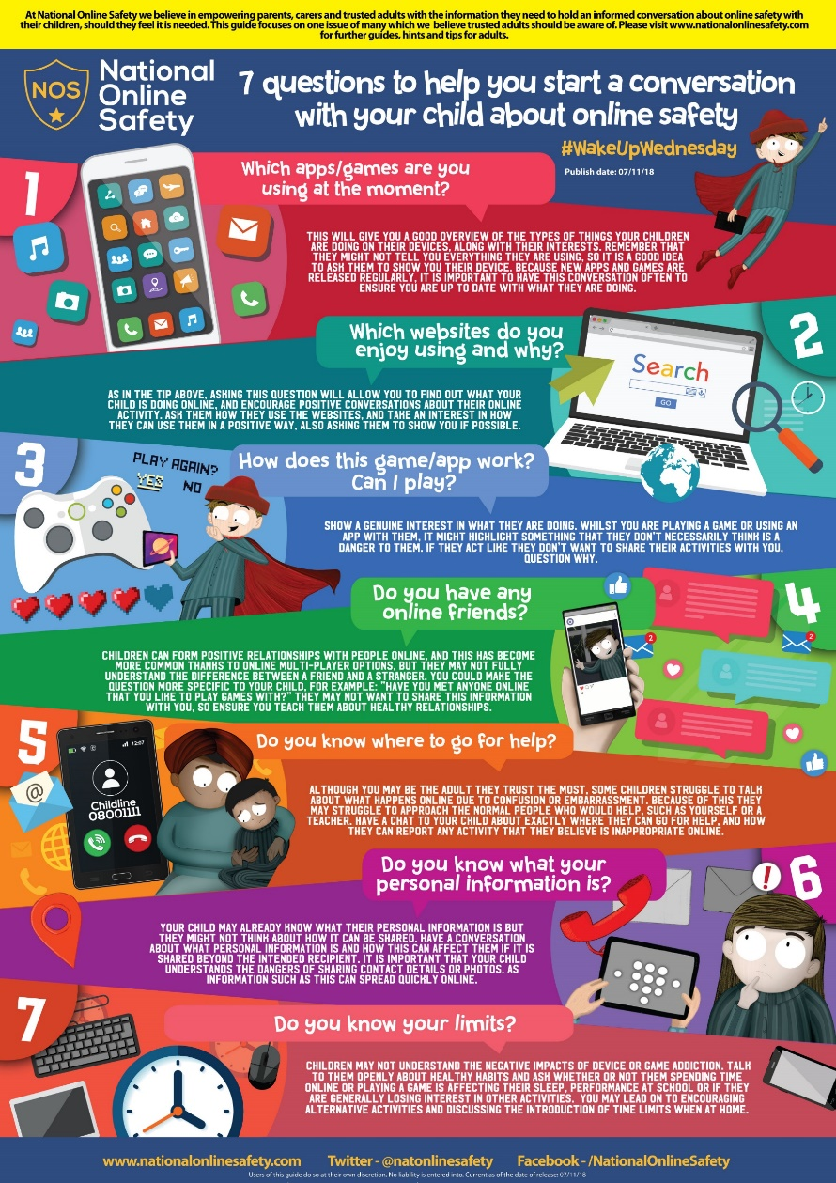
Supporting your child
Conversation topics
Think before you post
Be share aware
Role models
Time online
Online agreement
Notes:
There are many ways you can support your child online, but a key aspect will be opening up conversations about how your child is spending their time online.
You might open up a conversation about thinking before they post. Talk about how the things that someone does online paints a picture of themselves. Would they wear their comment on a t-shirt? Would they say it to a family member?
Some children might also benefit from conversations about being share aware. For example ,discussing which information you would want to share and wouldn’t such as where you live or go to school. Talk about the risks of sharing personal information as well as sharing thoughts and feelings or controversial opinions.
Be a good role model. Children learn by example. Make sure you are using the digital world in a positive way to teach them good habits
Limit time spent online. Set limits of when devices can be used. You might choose to ban phones from bedrooms to help encourage sleep.
Create an online agreement – verbally or written. Childnet has a good example of a family agreement. It might be things like no phones whilst eating, switch off devices at 9pm to reduce blue light.

Slide 42
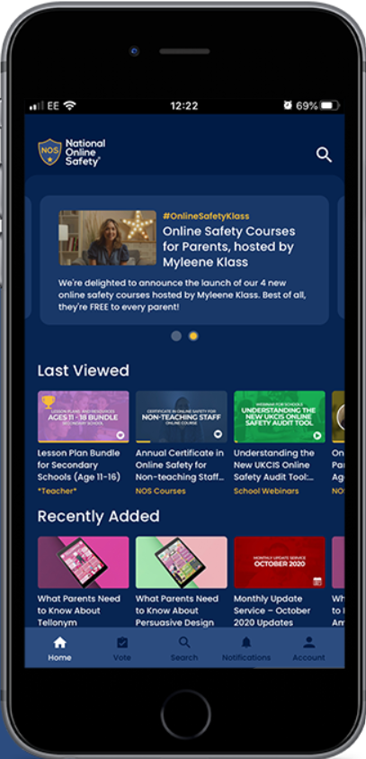
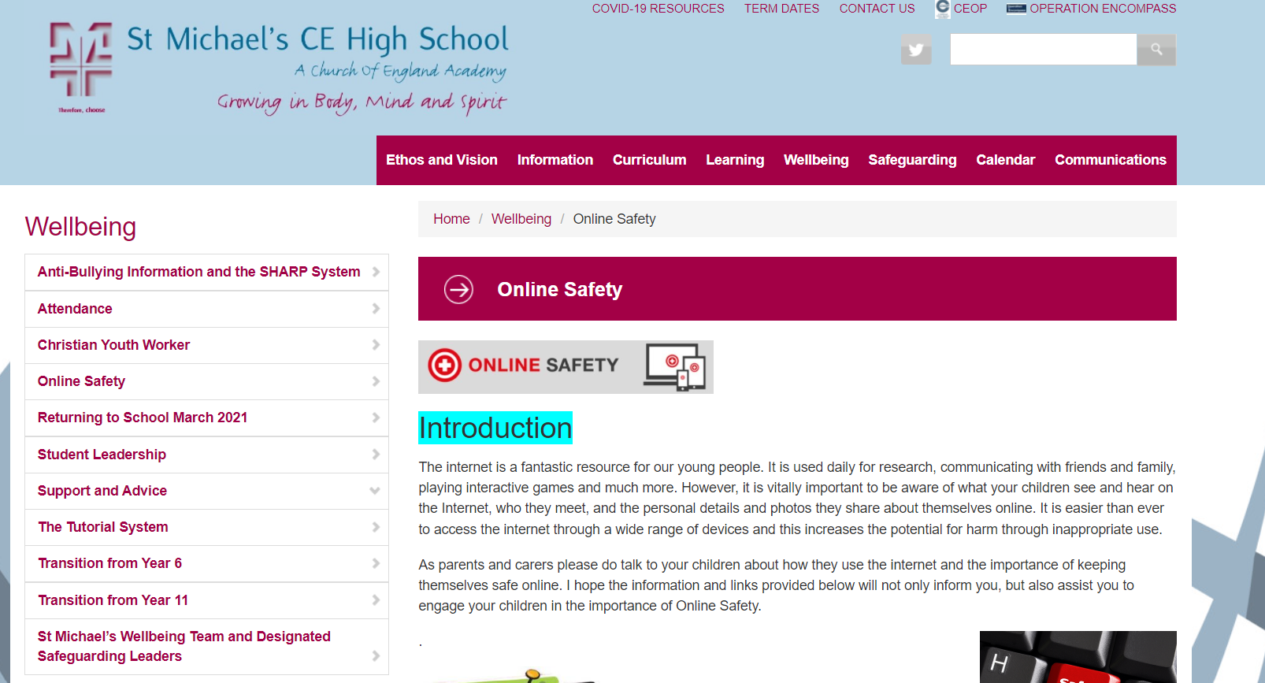
Supporting your child
Notes:
There are lots of helpful resources available online if you wish to look further about any of the apps. On the school website, on the wellbeing page under online safety there are links to many websites such as NSPCC, get safe online and think you know.
There are also a number of parent guides for common apps.
National Online Safety also have an app which is free to parents and they share lots of guides such as ‘What parents need to know about snapchat’ or ‘10 conversation starters about mental health’ as well as free courses.
Please get in touch if you have any further questions.
Thanks for listening.

Slide 43
Agenda
Welcome and Introduction Mrs J Jenks (Headteacher)
Wellbeing, Help and Support Mrs J Monaghan (Pupil Engagement Coordinator Wellbeing)
Compass Bloom Mental Health Support Team Chloe Murphy and Ruth Mills (Education Mental Health Practitioners)
Online Safety Miss L O’Malley (Online Safety/Prevent Coordinator)
Wellbeing Mr D Gow (Year 8 Pupil Manager)
Q&A information and Close Mr J Chadwick (Deputy Headteacher-Wellbeing)

Slide 44
i
Wellbeing
Rebalancing
My Top Tips – ‘Not a magic wand’
Talking to someone
Try to be calm and reassure
Distractions
Getting outside
Exercise
Routine
Sleep hygiene
Getting a pet
Keep checking in

Slide 45
Agenda
Welcome and Introduction Mrs J Jenks (Headteacher)
Wellbeing, Help and Support Mrs J Monaghan (Pupil Engagement Coordinator Wellbeing)
Compass Bloom Mental Health Support Team Chloe Murphy and Ruth Mills (Education Mental Health Practitioners)
Online Safety Miss L O’Malley (Online Safety/Prevent Coordinator)
Wellbeing Mr D Gow (Year 8 Pupil Manager)
Q&A information and Close Mr J Chadwick (Deputy Headteacher-Wellbeing)

Slide 46
St. Michael’s CE High School A Church of England Academy
Summary
Thank you!
Team St Michael’s
Feedback

Slide 47
St. Michael’s CE High School A Church of England Academy
Thank you for your attendance

